Slide 1


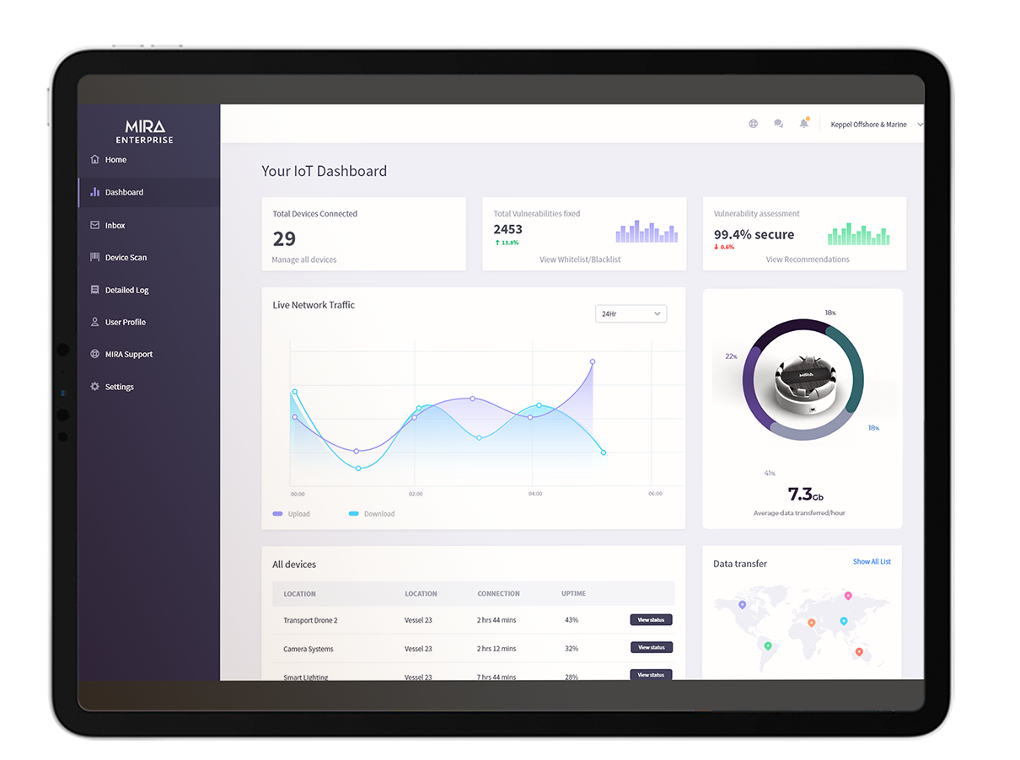
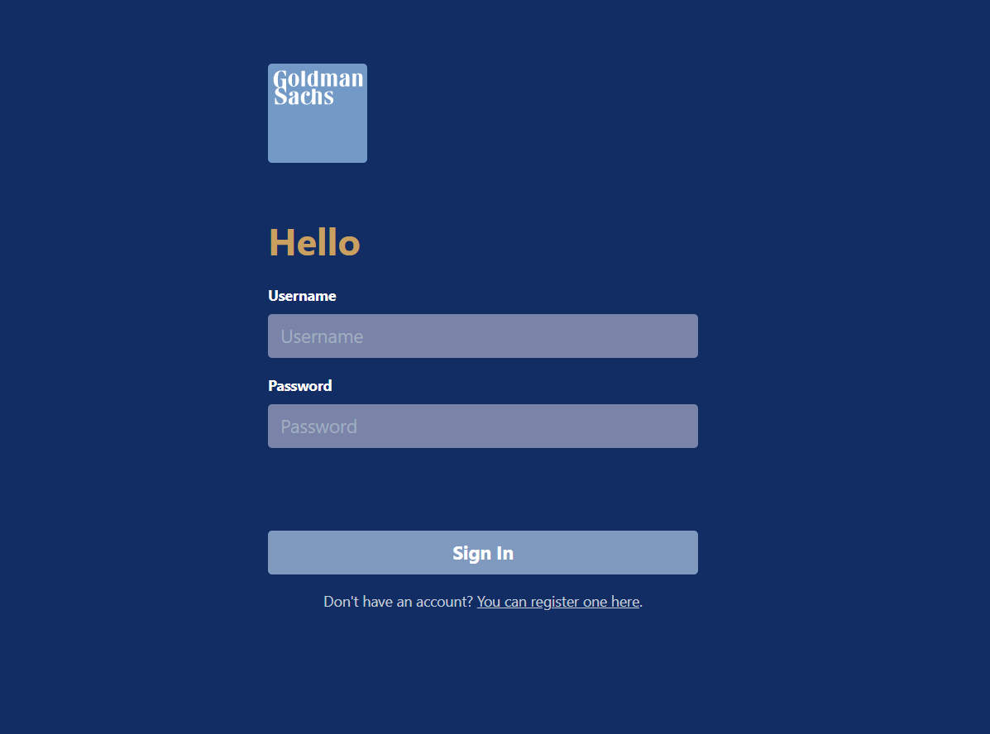

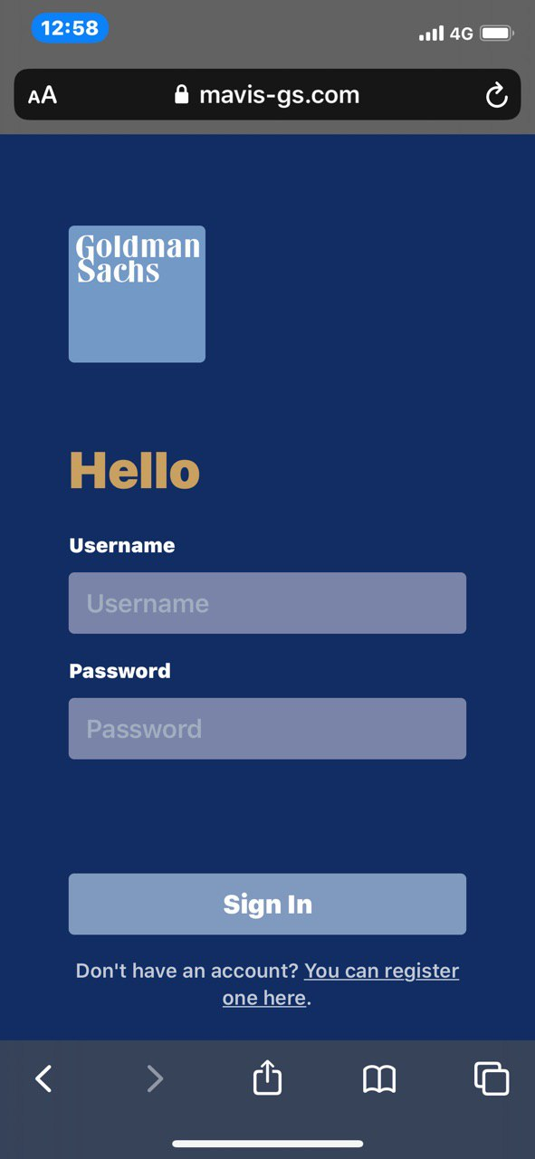


Mavis By Goldman Sachs
Mavis provides youths with easily accessible educational resources, personal financial dashboards, customised portfolio optimisation recommendations and a leaderboard for friends to make smart financial decisions together.
Developed by: Team Dusty Stick
*Best viewed through Mobile

Slide 2


PROBLEM STATEMENT & VALUE PROPOSITION
PROBLEM
Information Overload
Going Solo
Outdated or Misleading Advice
Goldman Sachs is spot on about the prevalence of an information overload which can deter many from starting their personal finance management journey. Our team emphasises very strongly on not showing meaningless graphs or incomprehensible finance jargon which only leads to more confusion.
As personal as personal finance gets, many youths feel that they are alone in mastering finance because managing personal financial situation can be sensitive and daunting.
Given the technology age that we are in, financial information are at youths' fingertips, where they are just one search away on the internet. However, the challenge comes with filtering through the myriad amount of information available, to find the information most suitable and to understand it.
Personalised Dashboard
Education First Approach
Community Driven
OUR CORE
TECHNOLOGIES
Youth Friendly
Increased Self-Awareness
Singapore Centric
Our team strongly emphasises the need for a product that will be able to fully serve the needs of youths with little to no financial literacy knowledge, to steer them through the vast amount of data and to not confuse them further with meaningless graphs and incomprehensible financial jargons. Our product will be easy to use and easy to understand.

Slide 3

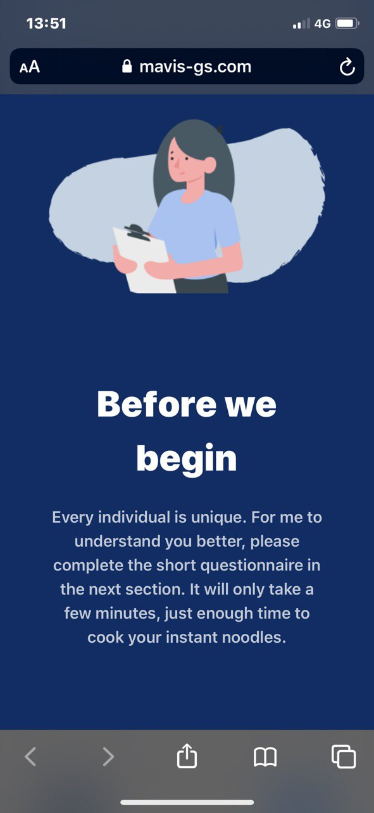
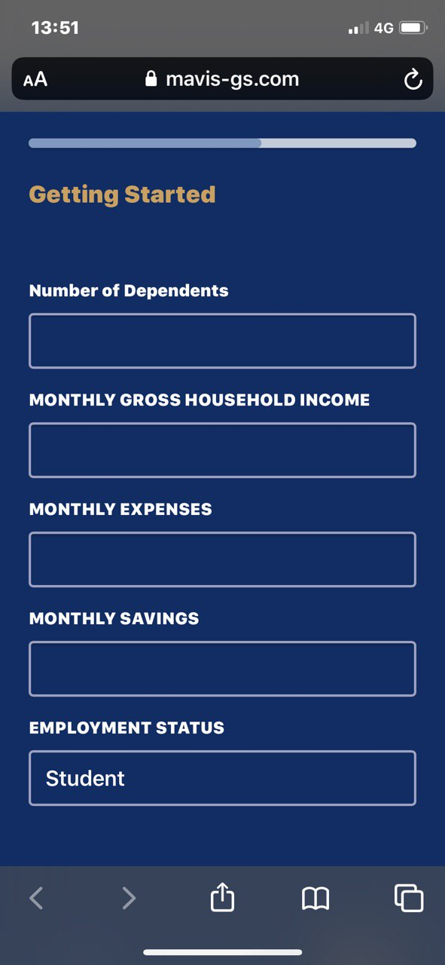
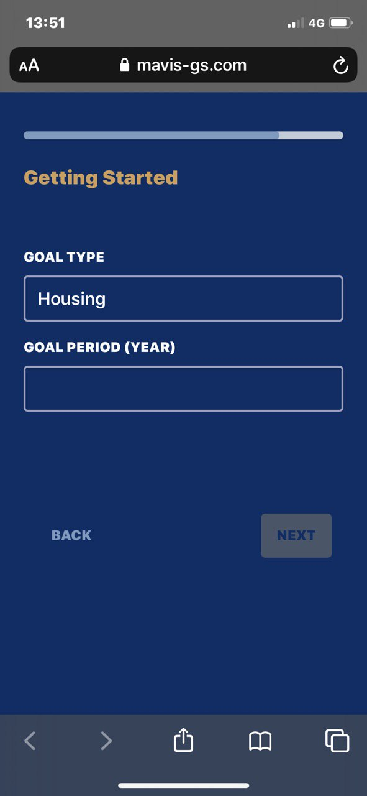
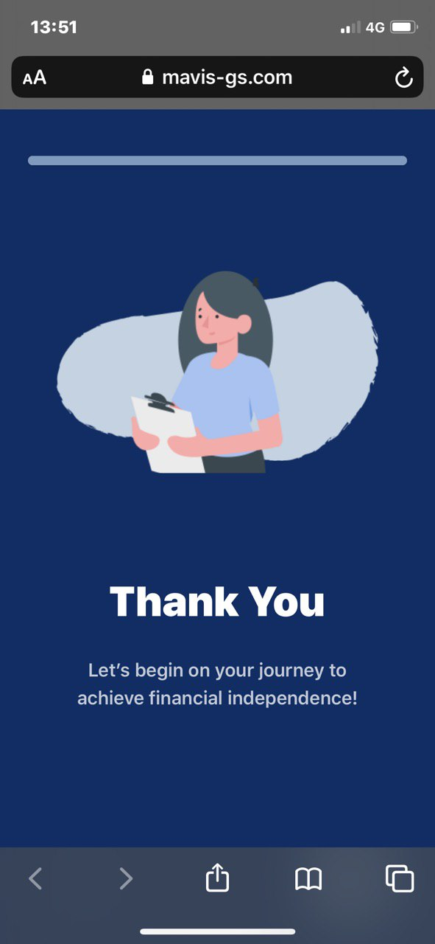

ONBOARDING WALKTHROUGH
1 REGISTER
2 QUESTIONNAIRE (PERSONAL FINANCE DETAILS)
3
QUESTIONNAIRE
(LEGACY, HEALTH, PERSONAL FINANCIAL GOALS)
4
YOU’RE ALL SET!

Slide 4


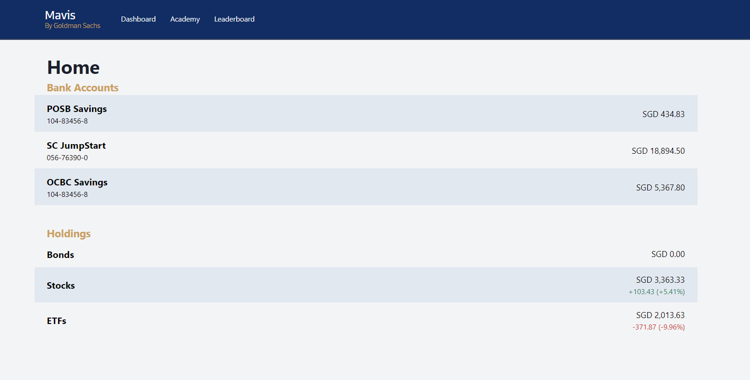
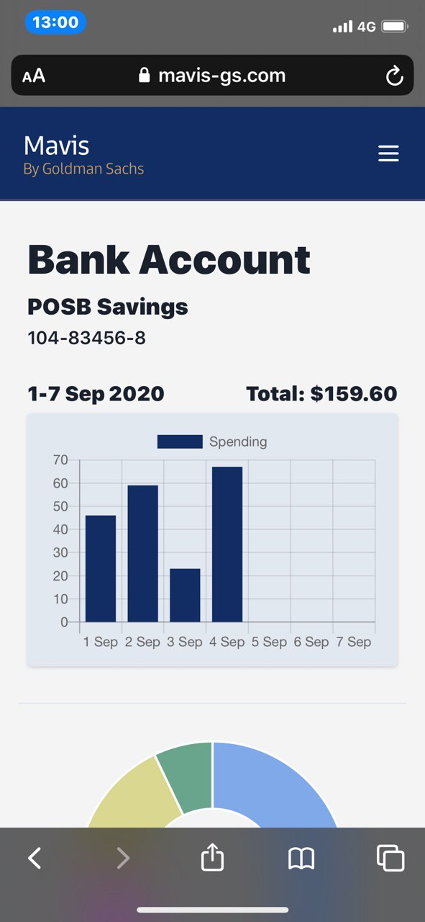
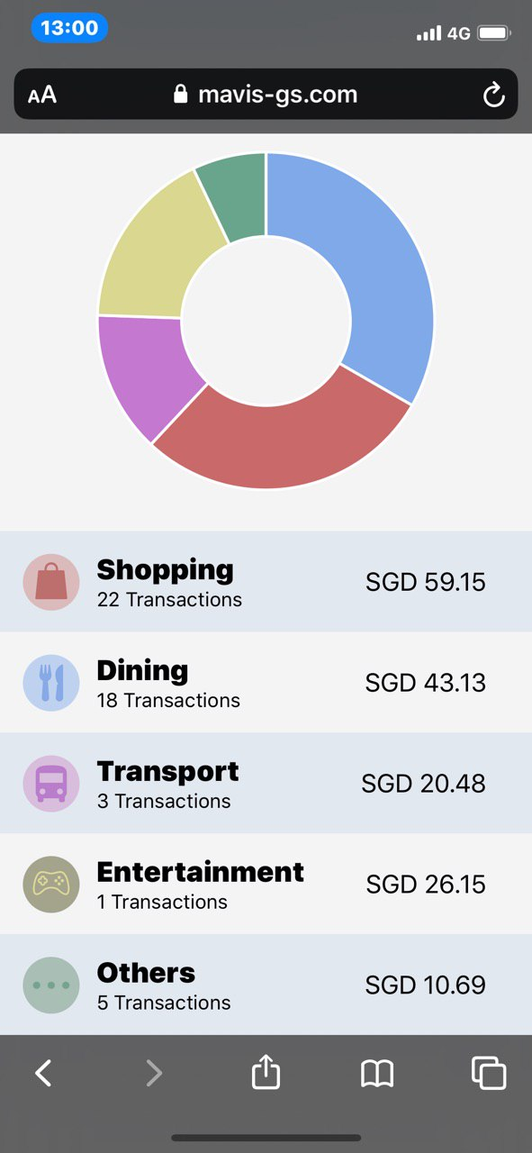


MAVIS – PERSONAL FINANCE DASHBOARD
Through the questionnaire the user fills in when they first create an account and the linking of their bank accounts, Mavis will be able to understand the user's personal financial portfolio, financial habits and characteristics.
Should the user have an investment portfolio, the personal finance dashboard will be able to monitor the user's investments in real time, which is supported by the Yahoo Finance API.
Notes:
Should the user become slightly more advanced with an investment portfolio, the personal finance dashboard will be able to monitor the user's investments in real time, which is supported by the Yahoo Finance API.

Slide 5

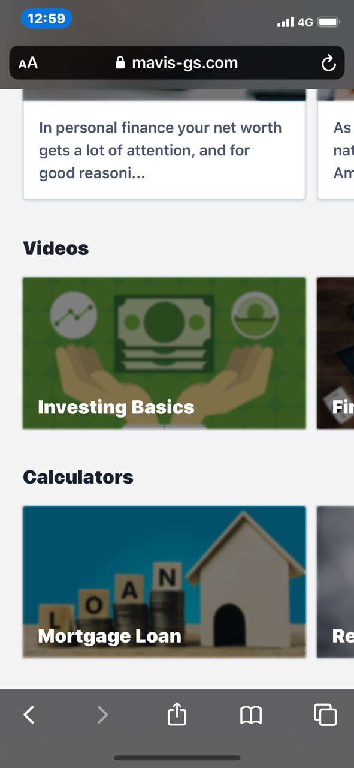
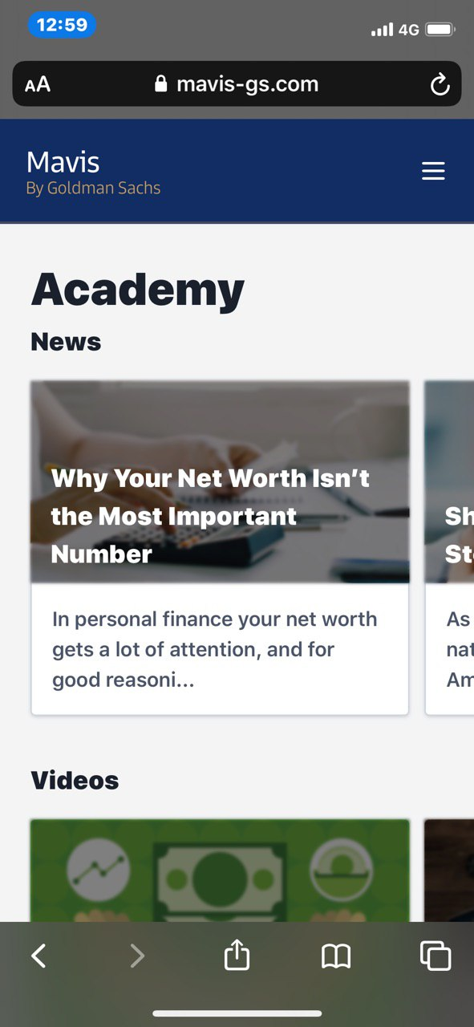
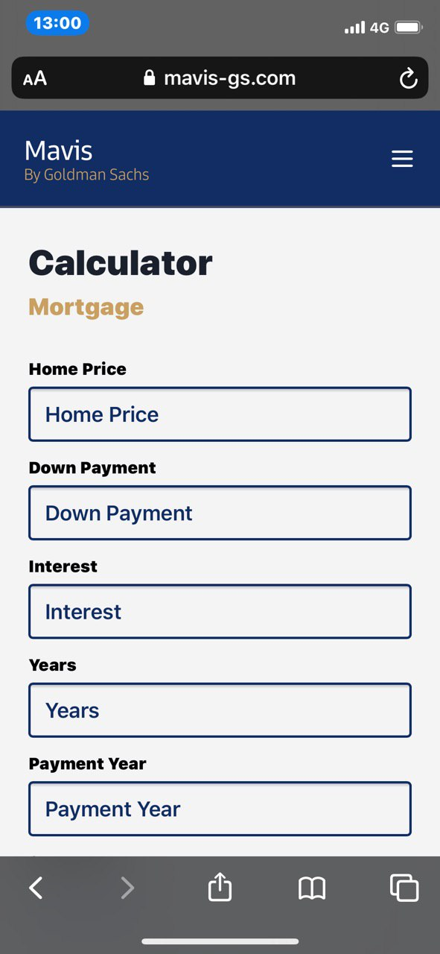

MAVIS ACADEMY
Videos, courses and news articles using the news API are readily available, and the completion of any educational resources will award coins to the user. The videos and courses are catered for all kinds of users, from beginners to advanced. There are personal finance calculators that are meant just for youths, such as mortgage payments calculator for BTO and student loan repayment calculator. This will better prepare youths for the future.
VIDEOS & COURSES
NEWS
CALCULATORS

Slide 6

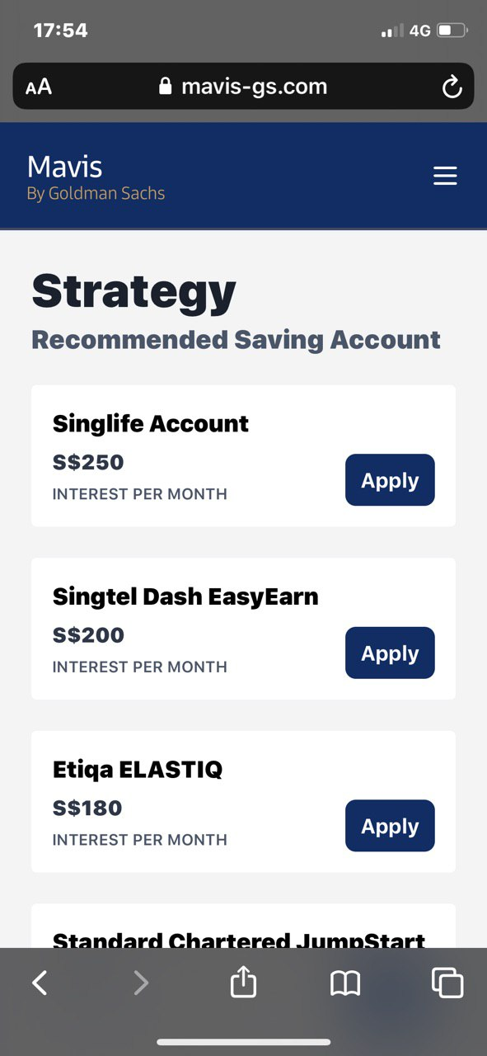
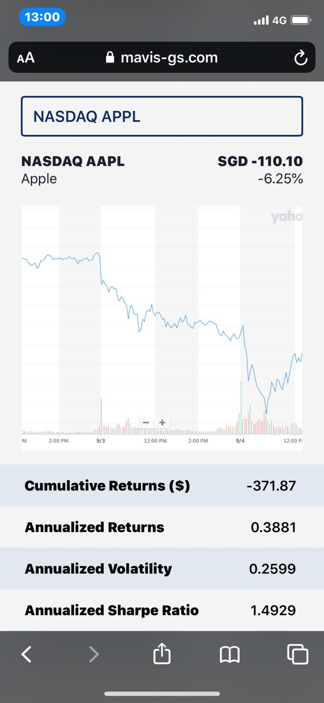
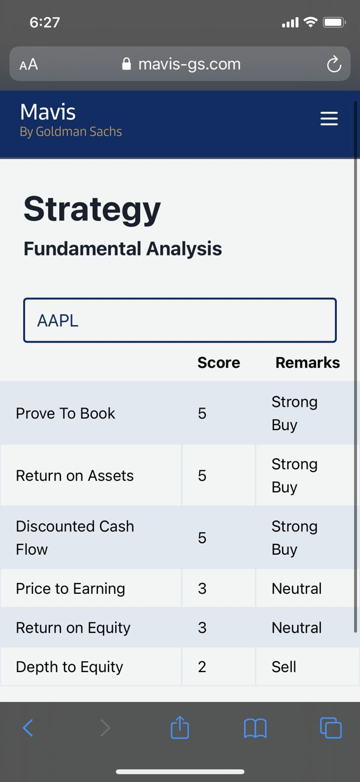

MAVIS STRATEGY
INSURANCE SAVINGS ACCOUNTS & SAVINGS ACCOUNTS RECOMMENDATION
‘WHAT IF’ PORTFOLIO PERFORMANCE ANALYSER
FUNDAMENTAL ANALYSIS
Now that users are confident and well equipped with basic to intermediate financial planning knowledge, users can consider moving to Mavis Strategy, where our financial models are best suited to benefit youths.
As inspired by Seedly, we recreated and improved the Savings Account Calculator to include Insurance Savings Accounts.
The list is inclusive of:
Singlife Account
Etiqa Elastiq
Standard Chartered Jumpstart
DBS Multiplier
Etc.
Using the Yahoo Finance API, based on the wealth index and drawdown chart, we can calculate the overall portfolio performance with updated data.
Cumulative returns ($)
Annualised Returns
Annualised Volatility Annualised Sharpe Ratio
Max Drawdown
Fundamental Analysis can be conducted on selected tickers for more informed purchase strategies. This is supported by FMP API.
Price to Book Ratio (B/E)
Return on Asset Ratio (ROE)
Discounted Cash Flow Valuation (DCF)
Price to Earnings Ratio (P/E)
Return on Equity (ROE)
Debt to Equity (D/E)

Slide 7
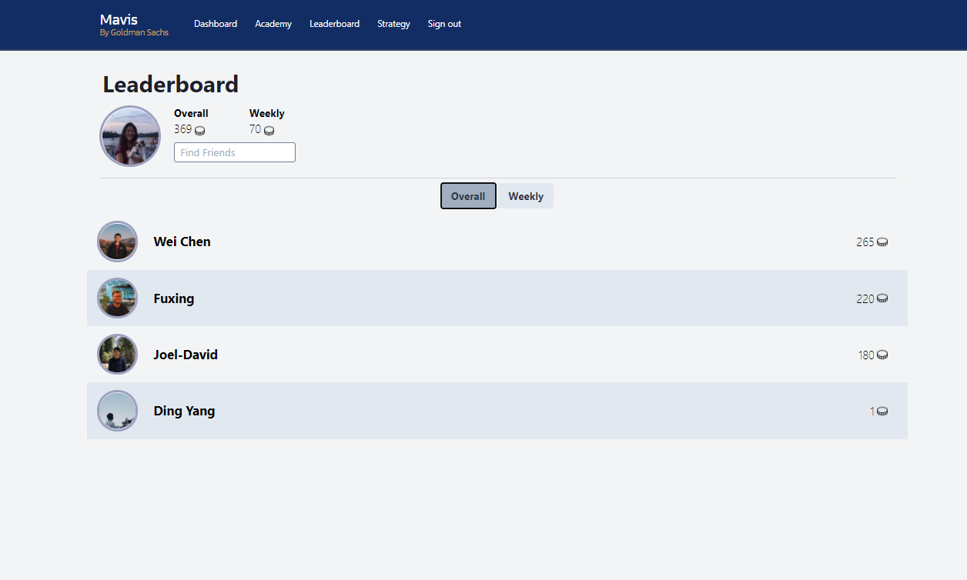


MAVIS – LEADERBOARD
We know that mastering personal financial planning is not an easy task. We believe, that if the journey is embarked on with friends, youths will feel more comfortable and supported. To encourage one another, we built a community leaderboard for users to add their friends and follow each other on their financial planning journey.

Slide 8
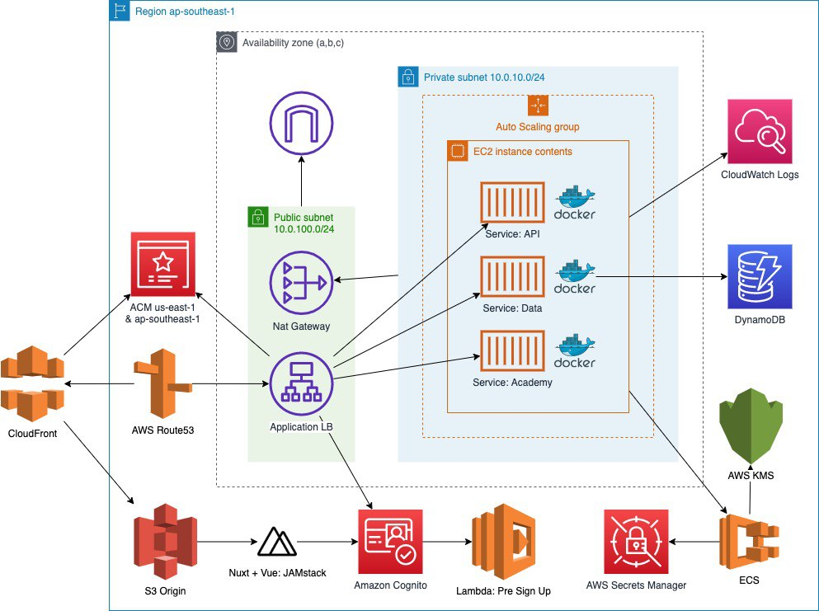
AWS ARCHITECTURE
Mavis is implemented with a Service-oriented architecture approach. The 3 core services are api, data and academy written in Python, Java and Node.js by 3 different engineers. They are deployed as docker containers in a AWS ECS cluster within a private subnet spread across multiple AZ.
An application load balancer is used to ingress traffic from the internet into the private subnet. The ECS services and EC2 instances has auto scaling to react to varying level of traffic. The ALB also serve as an edge proxy for TSL termination.
The web app is build with a vue JAMStack hosted on CloudFront with an S3 origin.
All user data are stored in DynamoDB with provisioned read/write capacity set to auto scale.
For security, all secrets are encrypted and only injected to the required containers to access external API. All services are hosted in private subnets with a nat gateway. Mavis VPC, IAM Policies and security group are tightly controlled to allow only what the service needs and nothing more.
Finally, the entire architecture is written in terraform as code. The pipelines are automated with continuous integration and continuous delivery. (Semantic Release, GitHub Workflows, Deploy on released)

Slide 9





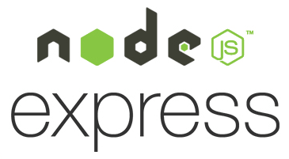





Tools & Framework
Semantic Release
GitHub Actions for CI
Python
Nuxt + Vue + TailwindCSS
Node.js + Express.js
Java, Spring Boot
Docker
Terraform
APIs and Open Source Datasets Used
Yahoo Finance API
Financial Modelling Prep API
life expectancy data from the CDC
http://www.econ.yale.edu/~shiller/data.htm
AWS Solutions
AWS Secrets Manager
AWS EC2
AWS ECS
AWS Application Load Balancer
AWS CloudFront
AWS S3
AWS CloudWatch Logs
Amazon Certification Manager
Amazon Route53
AWS Nat Gateway + Private Subnet
Amazon DynamoDB
AWS Auto Scaling Group
AWS App Auto Scaling
AWS Cognito
AWS Amplify [Not Yet Implemented]
TECHNOLOGY STACK
Python Libraries Used
flask==1.1.1
requests==2.23.0
pyjwt==1.7.1
numpy==1.15
pandas==0.24
python-dateutil==2.6.0
pytz==2016.10
simplejson==3.10.0
six==1.10.0
yahoo-finance==1.4.0
pandas-datareader==0.8.1
fix-yahoo-finance==0.0.20
yfinance==0.1.54
uncertainties==3.1.4
python-dotenv==0.14.0
FundamentalAnalysis==0.2.6
yahoofinancials==1.5
scipy==1.5.2 xlrd==1.2.0
Github Repositories Referenced
Szollosyg
Rbhatia46
Jhykes
*We have verified we have the required rights to use code snippets from online resources under the 3-clause BSD license.

Slide 10






Thank you
Proudly presented by:
Notes:
To be changed to cost analysis

